Slide 1



Noida Institute of Engineering and Technology, Greater Noida
Introduction to Computer Network
Unit: 1
Computer Networks
Ms. Akanksha
Asst. Professor
ECE
B Tech 5th Sem

Slide 2
Content
Course Objective
Course Outcome
CO-PO matrix
CO-PSO matrix
Prerequisite and Recap
Introduction to computer Network
Essential elements of CN
Types of Network
OSI Model
TCP/IP Model
Line configuration
Network Topology
Transmission media
Encoding

Slide 3
Course Objective
Introduction of computer networks with suitable transmission media and different networking devices. Network protocols which are essential for the computer network are need to explain such as data link layer protocols and routing protocols.
A detail explanation of IP addressing , TCP/IP protocols and application layer protocols are covered in this course.

Slide 4
Course Outcome
At the end of semester students will be able to
CO1:Explain basic concepts, OSI reference model, services and role of each
layer of OSI model and TCP/IP, networks devices and transmission
media, Analog and digital data transmission.
CO2: Apply channel allocation, framing, error and flow control techniques.
CO3: Describe the functions of Network Layer i.e. Logical addressing,
subnetting & Routing Mechanism.
CO4: Explain the different Transport Layer function i.e. Port addressing,
Connection Management, Error control and Flow control mechanism.
CO5: Explain the functions offered by session and presentation layer and their Implementation.
CO6: Explain the different protocols used at application layer i.e. HTTP,
SNMP, SMTP, FTP,TELNET and VPN.

Slide 5
CO-PO and PSO Mapping
Computer Networks(KCS- 603) |  |  |  |  |  |  |  |  | Year of Study: 2020-21
CO | PO1 | PO2 | PO3 | PO4 | PO5 | PO6 | PO7 | PO8 | PO9 | PO10 | PO11 | PO12
CO.1 | 3 | 2 | 2 |  | 2 |  |  |  | 2 |  | 2 | 3
CO.2 | 3 | 3 | 2 |  |  |  |  |  |  |  |  | 3
CO.3 | 3 | 3 | 3 | 3 | 2 |  |  |  | 2 |  | 2 | 3
CO.4 | 3 | 2 | 2 |  | 2 |  |  |  |  |  |  | 3
CO.5 | 3 | 3 | 2 |  | 2 | 3 |  | 2 |  |  |  | 3
CO.6 | 3 | 2 | 2 |  | 2 | 2 | 2 | 2 |  | 2 | 2 | 3

Slide 6
CO-PO and PSO Mapping
CO | PSO1 | PSO2 | PSO3 | PSO4
CO.1 | 2 | 2 | 2 | 2
CO.2 | 2 | 2 | 2 | 2
CO.3 | 2 | 2 | 2 | 3
CO.4 | 2 | 2 | 2 | 2
CO.5 | 2 | 2 | 2 | 2
CO.6 | 2 | 2 | 2 | 2

Slide 7
Prerequisite and Recap
Fundamental of Computer,
Interconnection of component of computer.

Slide 8
Introduction to computer Network
Objective: Study about basic concept of computer networks and its types
Computer Network
A computer network is a group of computers linked to each other that enables the computer to communicate with another computer and share their resources, data, and applications.
OR
A computer network is group of nodes (like computer, router,…),interconnected with media (wired or wireless ) for the purpose of sharing their resources, data, and applications.

Slide 9
Essential Elements of Communication
A message
A sender
A receiver
A medium

Slide 10
Three Network Subtypes
Local Area Network (LAN)
Metropolitan Area Network (MAN)
Wide Area Network (WAN)

Slide 11
LAN/MAN/WAN Comparison
LAN
MAN
WAN
Limited—typically up to 2,500 meters or 2 miles
High—typically in excess of 10 Mbps—10,100 and 1,000 are standard
Locally owned— twisted-pair wires, fiber optic cable, wireless (not satellite)
Can be any, but most are desktop computers
Limited—typically up to 00 kilometers or 100 miles
High—typically 100 Mbps
Locally owned and common carrier— twisted-pair wires, fiber optic cable
Can be any, but most are desktop computers and minicomputers
Unlimited
Slower—usually 1.5 Mbps
Locally owned and common carrier— twisted-pair wires, coaxial cable, fiber optic cable, wireless to include satellite
Can be any, but most are desktop computers
Distance
Speed
Media
Nodes

Slide 12
The OSI Reference Model
Objective: Study about OSI model & TCP/IP model with its function of each
layer
The problem of network interconnection is so important that the ISO created the OSI Reference Model that describes the functions a generic network needs to provide.
The OSI Reference Model has become the basis for many data communications standards.

Slide 13
OSI Peer Layer Communication
Processor 1
Processor 2
Application
Application
Presentation
Presentation
Session
Session
Transport
Transport
Network
Network
Data Link
Data Link
Physical
Physical
Logical Path
Physical Path

Slide 14
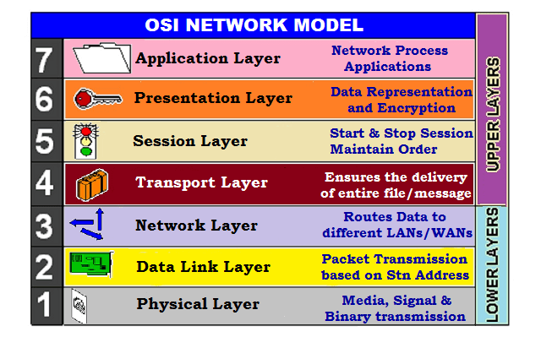
OSI Peer Layer Communication

Slide 15
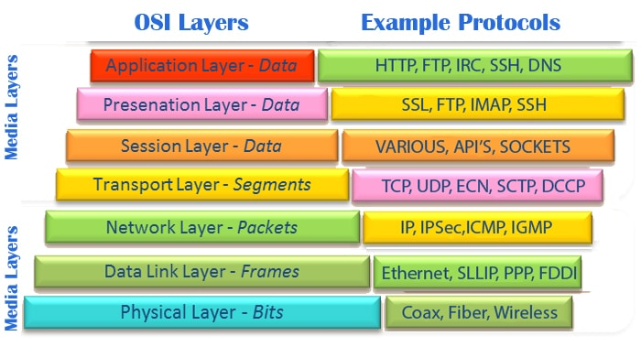
OSI Peer Layer Communication

Slide 16
OSI Peer Layer Communication
Application Layer
The application on Node A builds a record with a transaction identifier, the number of the account to be updated, the date and time of the transaction, and the amount to be deducted.
Presentation Layer
The presentation layer is responsible for translating from one format to another.
Session Layer
The session layer’s major functions are to set up and perhaps monitor a set of dialogue rules by which the two applications can communicate and to bring a session to an orderly conclusion.

Slide 17
OSI Peer Layer Communication
Transport Layer
The transport layer is the first of the OSI layers responsible for actually transmitting the data.
Network Layer
The network layer provides accounting and routing functions.
Data Link Layer
The data link layer is responsible for data delineation, error detection, and logical control of the link.
Physical Layer
The physical layer does not append anything to the message. It simply accepts the message from the data link layer and translates the bits into signals on the medium.

Slide 18
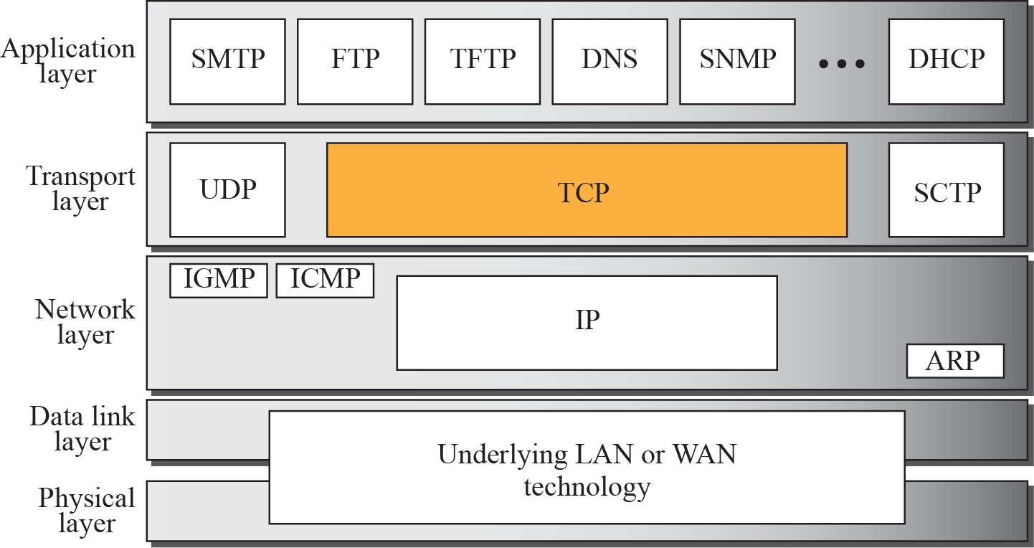
TCP/IP Model OR INTERNET MODEL
Processor 1
Processor 2
Application
Application
Presentation
Presentation
Session
Session
Transport
Transport
Network
Network
Data Link
Data Link

Slide 19
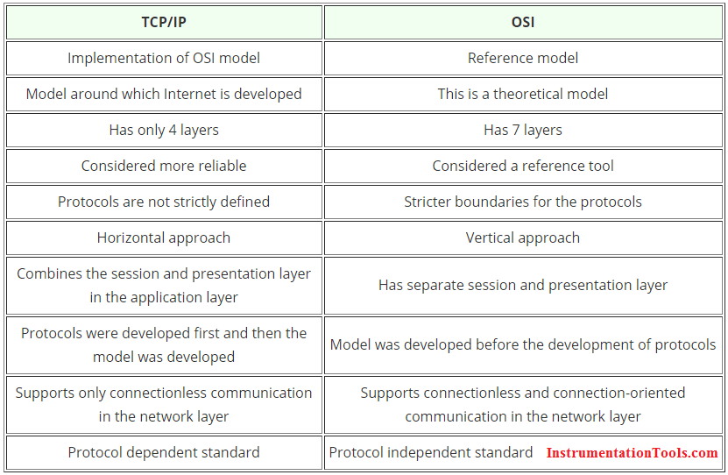
TCP/IP Model VS. OSI MODEL
TCP/IP vs. OSI Model

Slide 20
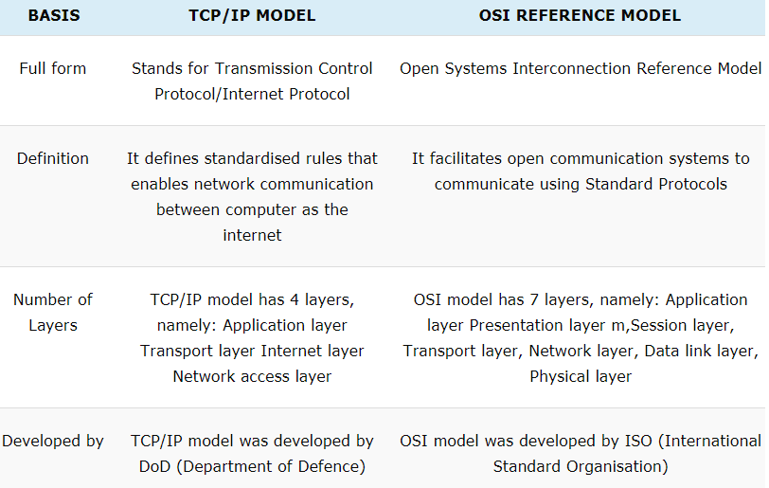
TCP/IP Model VS. OSI MODEL

Slide 21
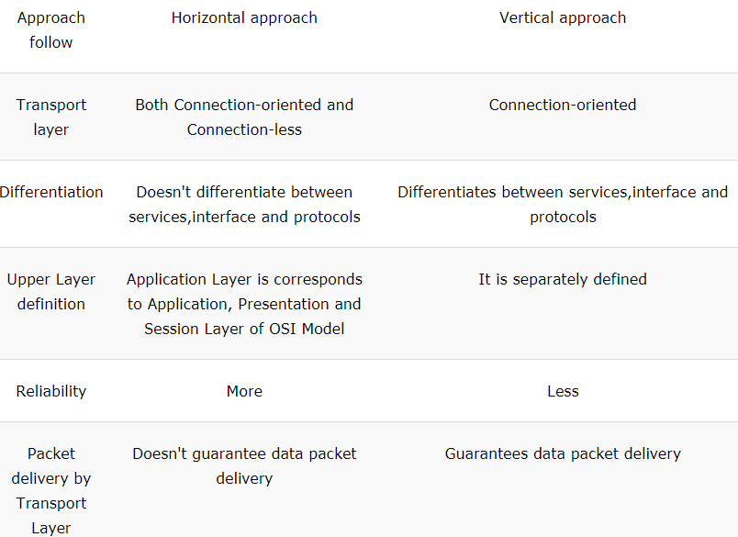
TCP/IP Model VS. OSI MODEL

Slide 22
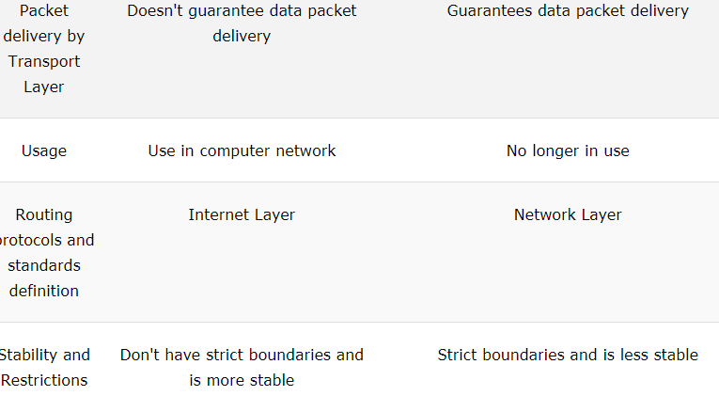
TCP/IP Model VS. OSI MODEL

Slide 23
LAN
Type of Network
A LAN services a limited geographic area at high speeds—usually 10 million bits per second or higher. All components of the LAN are commonly owned by the organization that uses it.
The nodes in many of today’s LANs are desktop systems like personal computers. Henceforth, we will also use the terms workstations, clients, and servers in referring to LAN nodes.
A workstation is used here to represent a LAN user’s computer; other terms used in referring to a workstation are client and node.
A server is a network node that is dedicated to providing services to client nodes.

Slide 24
MAN
Type of Network
A MAN (metropolitan area network) is a high-speed network covering wider distances than LAN.
A MAN spans distances of approximately 100 miles; therefore, it is suitable for connecting devices and LANs in a metropolitan area.
MAN speeds are typically 100 Mbps or higher.
The most commonly implemented MAN is the fiber distributed data interface (FDDI). It operates at 100 Mbps over fiber optic cable for distances up to 200 kilometers.

Slide 25
WAN
Type of Network
A WAN is the oldest type of network.
WANs generally span a wide geographic area like a state, province, country, or multiple countries. However, some WANs are confined to a limited geographic area, like a LAN.
A WAN in a limited geographic area could be easily extended over a wide area using the same technologies. The same is not true of a LAN.

Slide 26
General Network Implementations: VANs
Type of Network
A VAN is a network owned by a communications utility that sells the services of the network to other companies.
A communications utility that owns a VAN provides connectivity to multiple locations.
The value added by the communications utility is the maintenance and management of the communications circuits.

Slide 27
General Network Implementations: Enterprise Networks
Type of Network
An enterprise network is an organization’s complete network.
With the advent of LANs, many companies installed departmental LANs to improve the productivity of work groups.
Soon, these companies realized that there was a benefit to having users on one LAN communicate with users or applications on other LANs or on the WAN, and the various networks were connected together to form one corporate-wide network, the enterprise network.

Slide 28
General Network Implementations: The Internet
Type of Network
An internet (with a lowercase ‘i’) is the interconnection of two or more networks. An enterprise networks just described is an example of an internet.
An internet is any set of interconnected Internet Protocol (IP) networks. the Internet is an internet, but the reverse does not apply. The Internet is sometimes called the connected internet.
The Internet (with an uppercase ‘I’) is a specific instance of an internet.
The Internet is a global network of networks. The Internet is made up of hundreds of networks, thousands of nodes, and millions of users throughout most countries of the world.

Slide 29
General Network Implementations: Intranets
Type of Network
An intranet is an organization’s private Web.
Companies have found that WWW capabilities can improve the information flow and availability in a company.
Companies may use an intranet rather than publishing on the Internet because the information being provided is intended for corporate use only and not for the public at large.

Slide 30
Mode of Transmission

Slide 31
Simplex
Examples:
1. Radio broadcasting 2. Television broadcasting
3. computer to printer communication 4. Keyboard and monitor

Slide 32
Half-Duplex
Examples:
Walkie-Talkie, 2. a two-way radio that has a push-to-talk button
3. One way road used for both side traffic but not at a same time

Slide 33
Full-Duplex
Examples:
Telephone network and Mobile network

Slide 34
Line configuration
Examples:
Mesh Topology
Ring Topology
Star Topology
Examples:
Bus Topology

Slide 35
Point-to-Point Line Configuration

Slide 36
Point-to-Point Line Configuration

Slide 37
Point-to-Point Line Configuration

Slide 38
Multipoint Line Configuration

Slide 39
Network Topology

Slide 40
Network Topology
Mesh Topology

Slide 41
Network Topology
Mesh Topology
No. of keys = 6
If N is node then no. of connection=
n(n-1)/2
When N=5
Key= 10,
When N=50
Key= ,

Slide 42
Network Topology
Star Topology

Slide 43
Network Topology
Tree Topology

Slide 44
Network Topology
Bus Topology

Slide 45
Network Topology
Hybrid Topology

Slide 46
Network Topology
Ring Topology

Slide 47
Network Topology
Summary of Topology
If N no. of nodes
Types of Topology/No. of connection
Mesh N(N-1) / 2
Star N (excluding HUB), N-1 (Including HUB)
Bus N + 1 (for backbone cable)
Ring N

Slide 48
Transmission Media
Guided Media
Unguided Media

Slide 49
Transmission Media
Objective: Study about basic concept of Transmission media and uses in different
place.

Slide 50
Transmission Media
1. Guided Media: It is also referred to as Wired or Bounded transmission media. Signals being transmitted are directed and confined in a narrow pathway by using physical links. Features:
High Speed
Secure
Used for comparatively shorter distances
There are 3 major types of Guided Media:
Twisted Pair Cable – It consists of 2 separately insulated conductor wires wound about each other. Generally, several such pairs are bundled together in a protective sheath. They are the most widely used Transmission Media. Twisted Pair is of two types:
Unshielded Twisted Pair (UTP)
Shielded Twisted Pair (STP)

Slide 51
Transmission Media
Unshielded Twisted Pair (UTP): This type of cable has the ability to block interference and does not depend on a physical shield for this purpose. It is used for telephonic applications. Advantages:
Least expensive
Easy to install
High-speed capacity
Shielded Twisted Pair (STP): This type of cable consists of a special jacket to block external interference. It is used in fast-data-rate Ethernet and in voice and data channels of telephone lines. Advantages:
Better performance at a higher data rate in comparison to UTP
Eliminates crosstalk
Comparatively faster
Comparatively difficult to install and manufacture
More expensive

Slide 52
Transmission Media
Coaxial Cable – It has an outer plastic covering containing 2 parallel conductors each having a separate insulated protection cover. The coaxial cable transmits information in two modes: Baseband mode(dedicated cable bandwidth) and Broadband mode(cable bandwidth is split into separate ranges). Cable TVs and analog television networks widely use Coaxial cables.
Advantages:
High Bandwidth
Better noise Immunity
Easy to install and expand
Optical Fibre Cable – It uses the concept of reflection of light through a core made up of glass or plastic. The core is surrounded by a less dense glass or plastic covering called the cladding. It is used for the transmission of large volumes of data.
The cable can be unidirectional or bidirectional. The WDM (Wavelength Division Multiplexer) supports two modes, namely unidirectional and bidirectional mode.
Advantages:

Slide 53
Transmission Media
Advantages:
Increased capacity and bandwidth
Lightweight
Less signal attenuation
Immunity to electromagnetic interference
Resistance to corrosive materials
Disadvantages:
Difficult to install and maintain
High cost
Fragile

Slide 54
Twisted-Pair Cable

Slide 55
Noise Effect

Slide 56
Transmission media
Noise on Twisted-Pair Lines

Slide 57
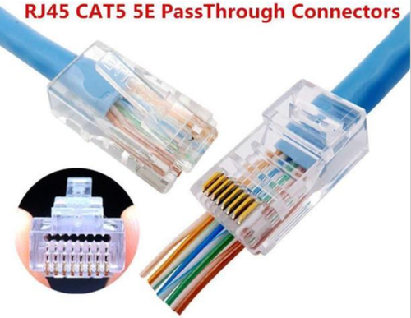
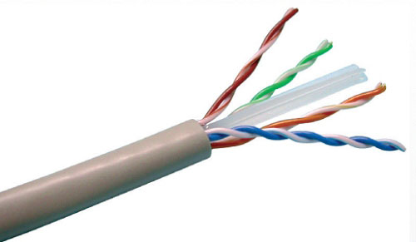
Transmission media
Unshielded Twisted-Pair Cable

Slide 58
Figure 7-9
Transmission media
UTP Connectors

Slide 59
Transmission media
Shielded Twisted-Pair Cable

Slide 60
Transmission media
Coaxial Cable

Slide 61
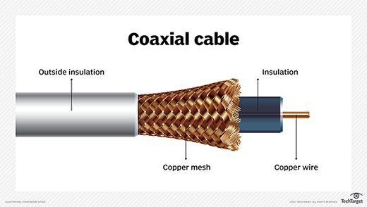
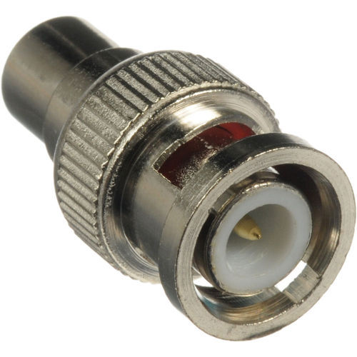
Transmission media
BNC- Standing for Bayonet Neil-Concelman, this connector is used with television, video signal and radio below a frequency of 4GHz

Slide 62
Transmission media
Refraction

Slide 63
Transmission media
Critical Angle

Slide 64
Transmission media
Figure 7-15
Reflection

Slide 65
Transmission media

Slide 66
Transmission media
Multimode Step-Index

Slide 67
Transmission media
Multimode Graded-Index

Slide 68
Transmission media
Single Mode

Slide 69
Transmission media
Fiber Construction

Slide 70
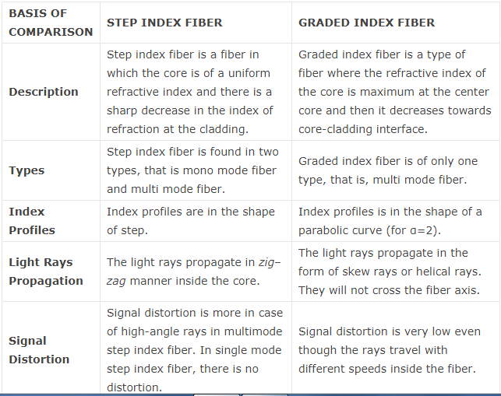
Transmission media
Step Index vs. Graded Index

Slide 71
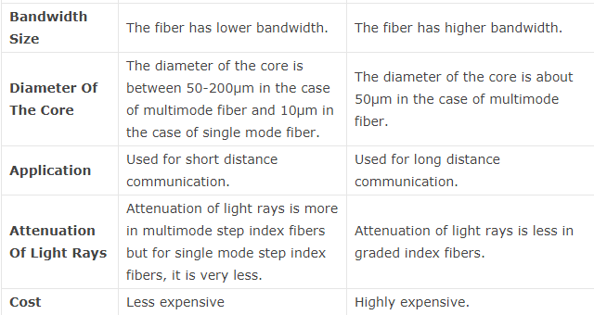
Transmission media

Slide 72
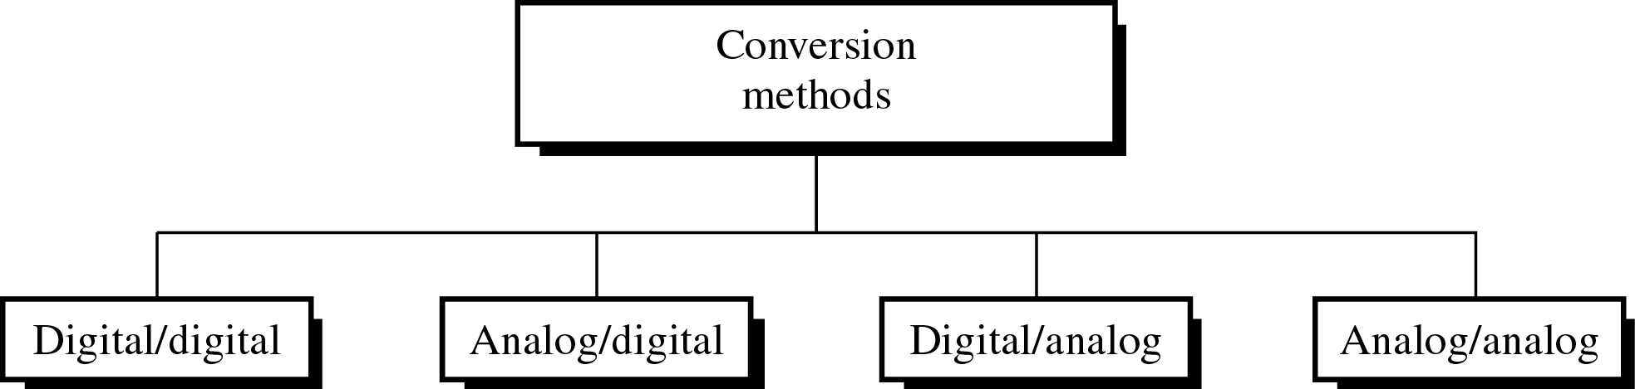
Encoding
Objective: Study about basic concept of Encoding techniques and its types
Different Conversion Schemes

Slide 73
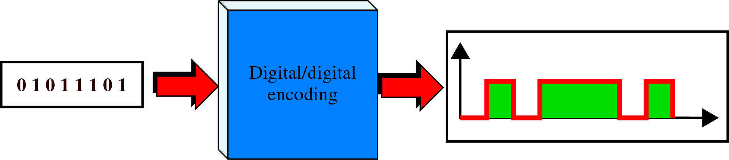
Encoding
Digital to Digital Encoding

Slide 74
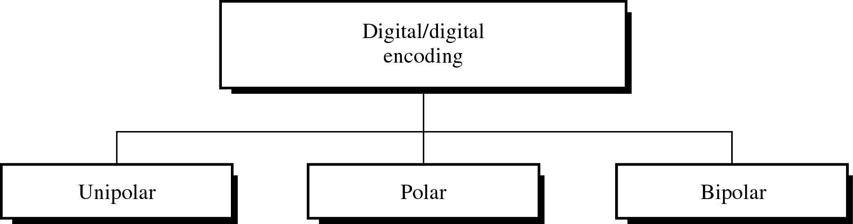
Encoding
Types of Digital to Digital Encoding

Slide 75
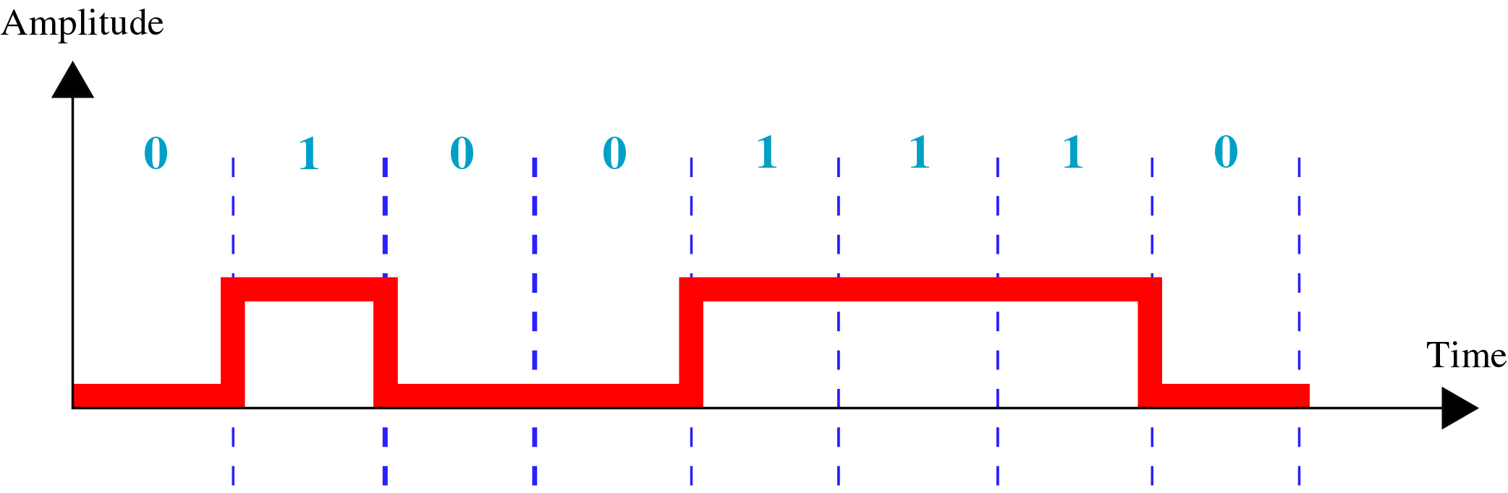
Encoding
Unipolar Encoding

Slide 76
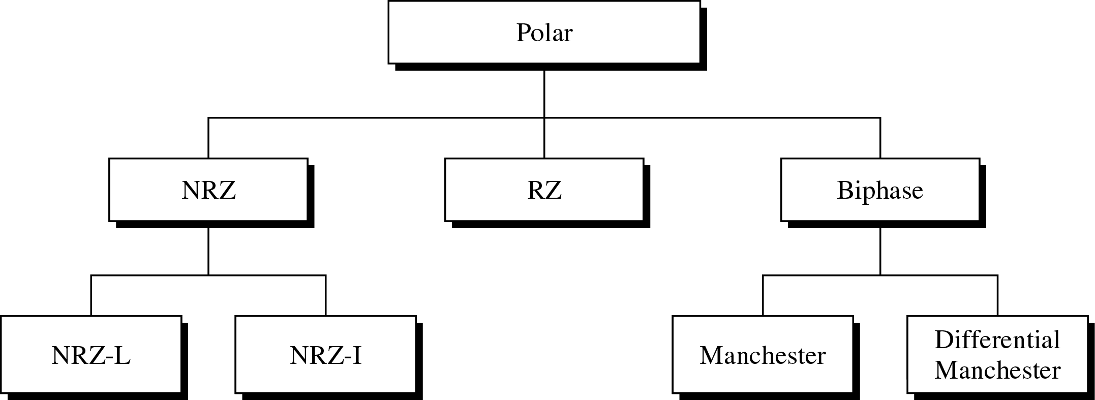
Encoding
Types of Polar Encoding

Slide 77
Encoding
Encoding is the process of converting the data or a given sequence of characters, symbols, alphabets etc., into a specified format, for the secured transmission of data.
Decoding is the reverse process of encoding which is to extract the information from the converted format.
Data Encoding
Encoding is the process of using various patterns of voltage or current levels to represent 1s and 0s of the digital signals on the transmission link.
Non Return to Zero NRZ
NRZ Codes has 1 for High voltage level and 0 for Low voltage level. The main behavior of NRZ codes is that the voltage level remains constant during bit interval. The end or start of a bit will not be indicated and it will maintain the same voltage state, if the value of the previous bit and the value of the present bit are same.
The following figure explains the concept of NRZ coding.

Slide 78
Encoding
NRZ - L NRZ–LEVEL
There is a change in the polarity of the signal, only when the incoming signal changes from 1 to 0 or from 0 to 1. It is the same as NRZ, however, the first bit of the input signal should have a change of polarity.
NRZ - I NRZ–INVERTED
If a 1 occurs at the incoming signal, then there occurs a transition at the beginning of the bit interval. For a 0 at the incoming signal, there is no transition at the beginning of the bit interval.
NRZ codes has a disadvantage that the synchronization of the transmitter clock with the receiver clock gets completely disturbed, when there is a string of 1s and 0s. Hence, a separate clock line needs to be provided.

Slide 79
Encoding
Bi-phase Manchester
In this type of coding, the transition is done at the middle of the bit-interval. The transition for the resultant pulse is from High to Low in the middle of the interval, for the input bit 1. While the transition is from Low to High for the input bit 0.
Differential Manchester
In this type of coding, there always occurs a transition in the middle of the bit interval. If there occurs a transition at the beginning of the bit interval, then the input bit is 0. If no transition occurs at the beginning of the bit interval, then the input bit is 1.

Slide 80
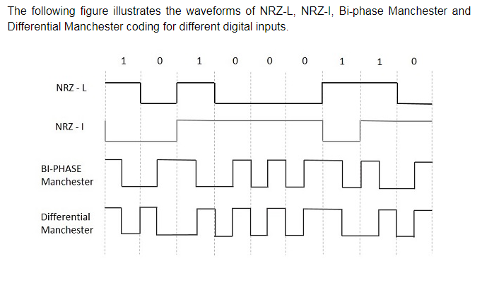
Encoding

Slide 81
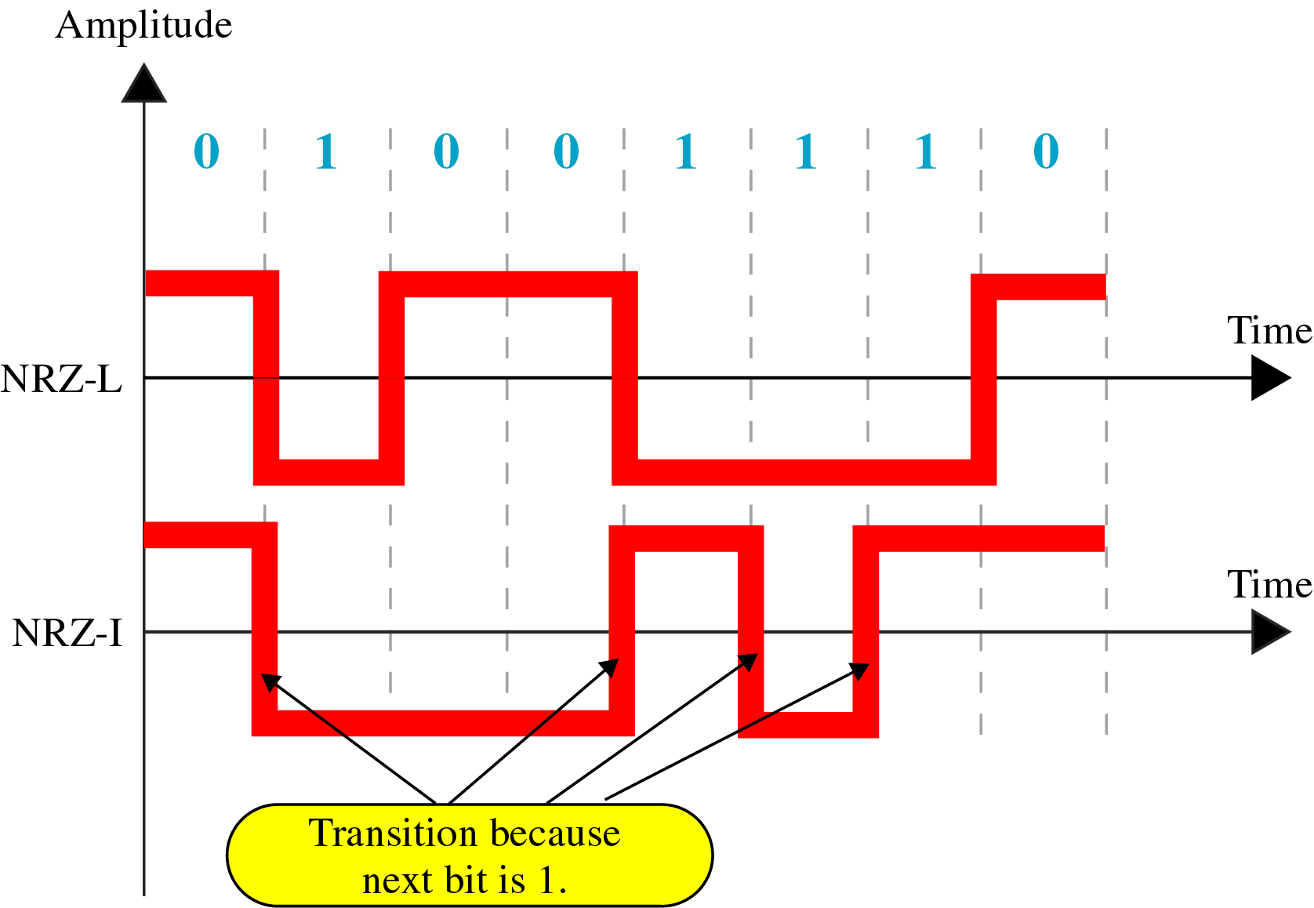
Encoding
NRZ-L and NRZ-I Encoding

Slide 82
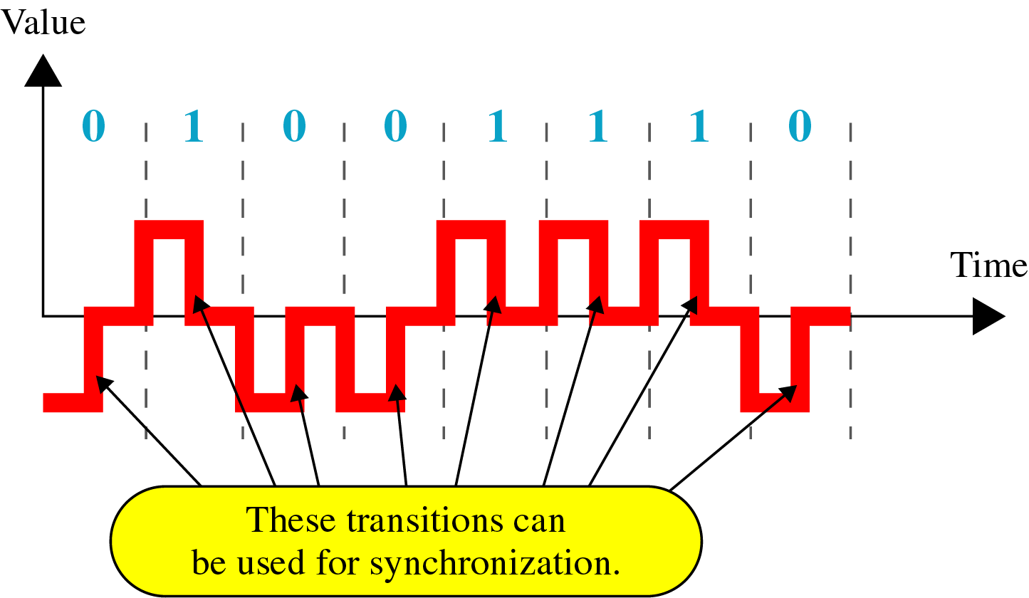
Encoding
RZ Encoding

Slide 83
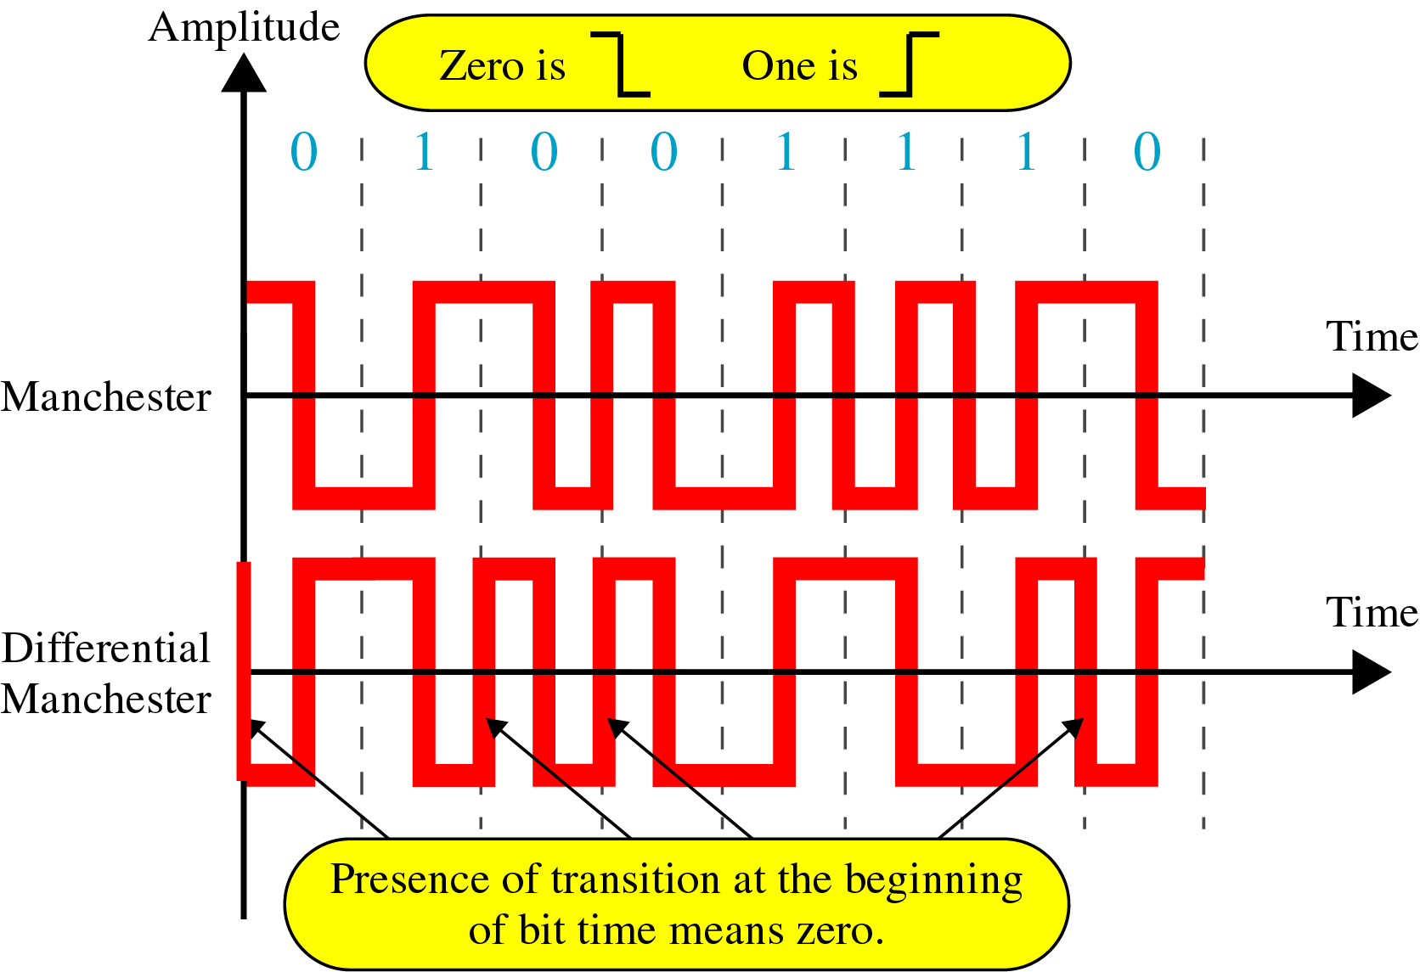
Encoding
Manchester and Diff. Manchester Encoding

Slide 84
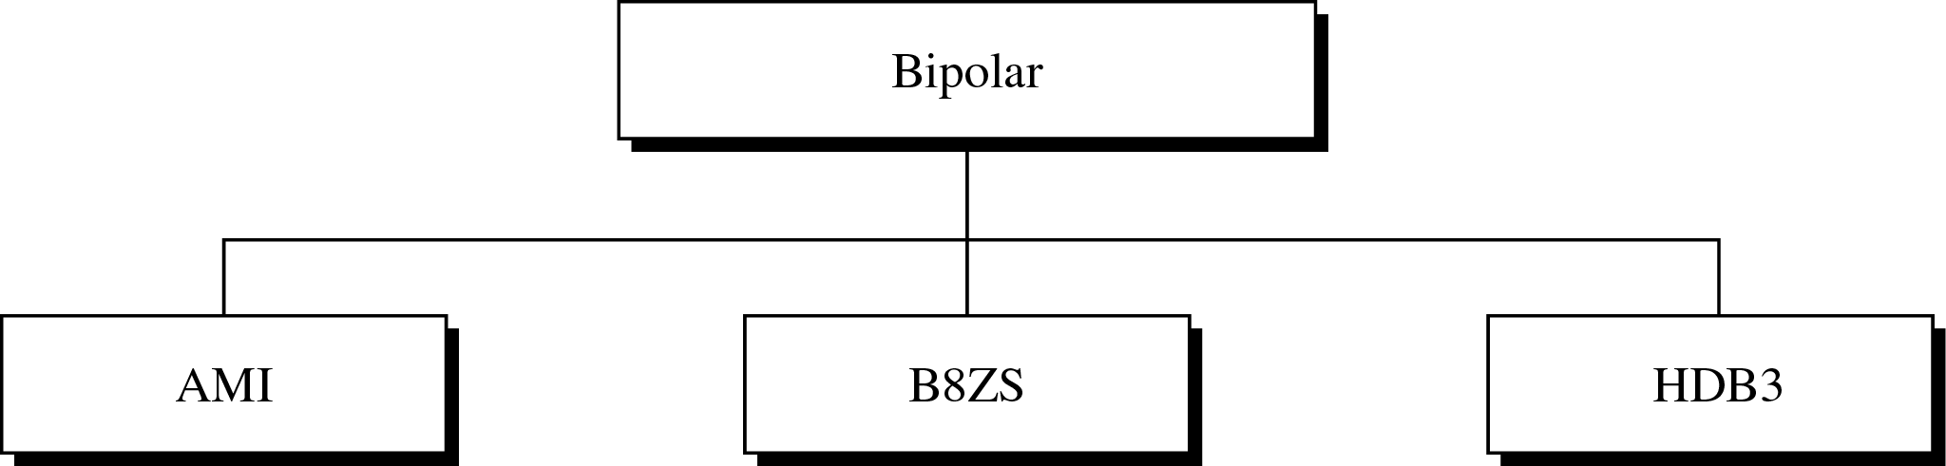
Encoding
Types of Bipolar Encoding

Slide 85
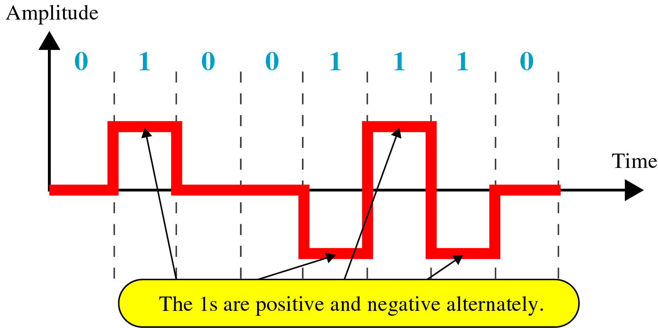
Encoding
Bipolar AMI Encoding

Slide 86
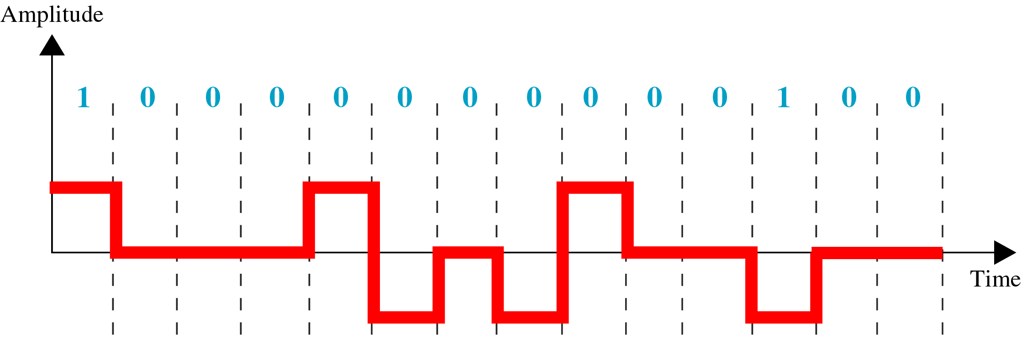
Encoding
Example

Slide 87
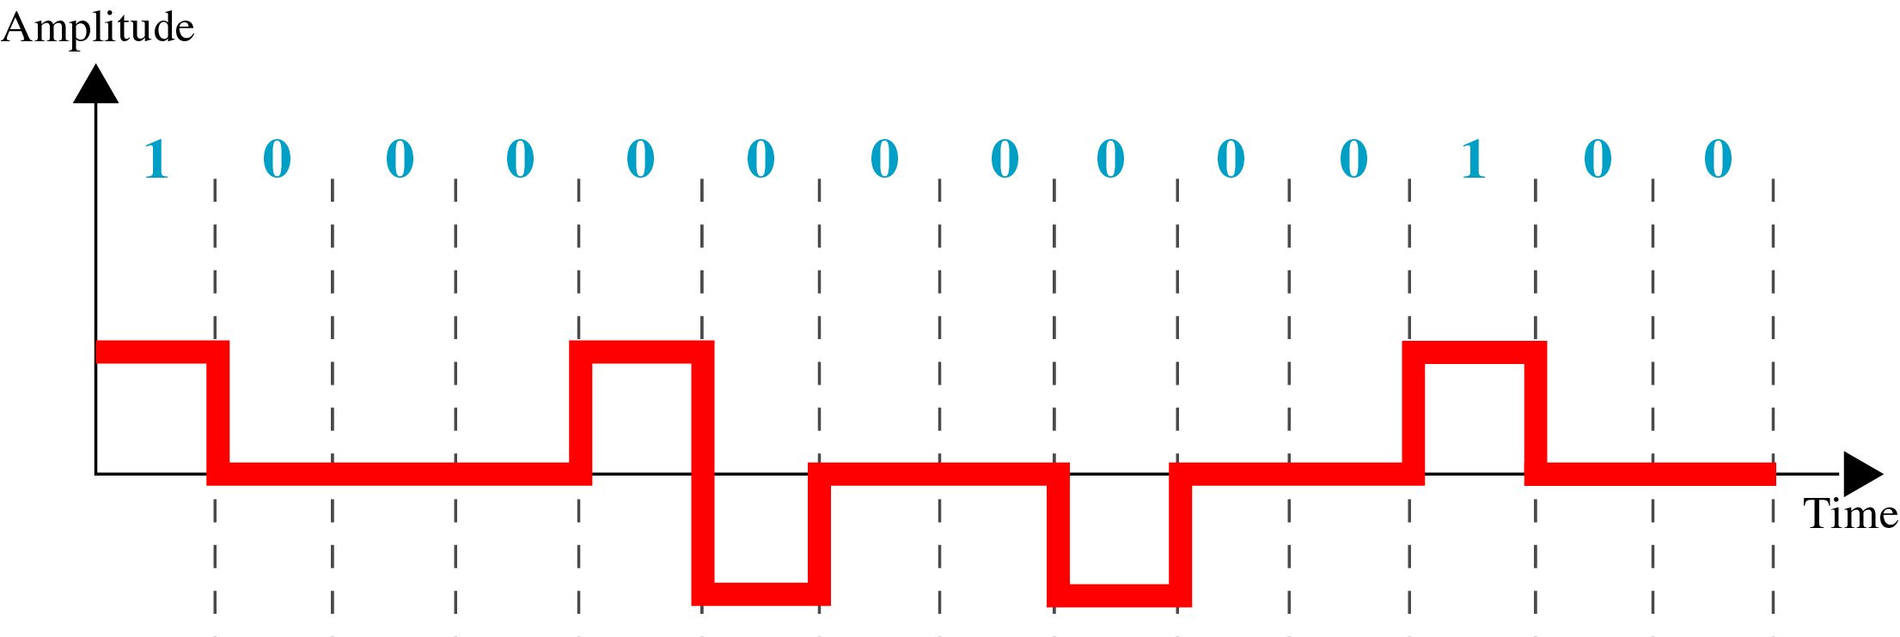
Encoding
Example

Slide 88
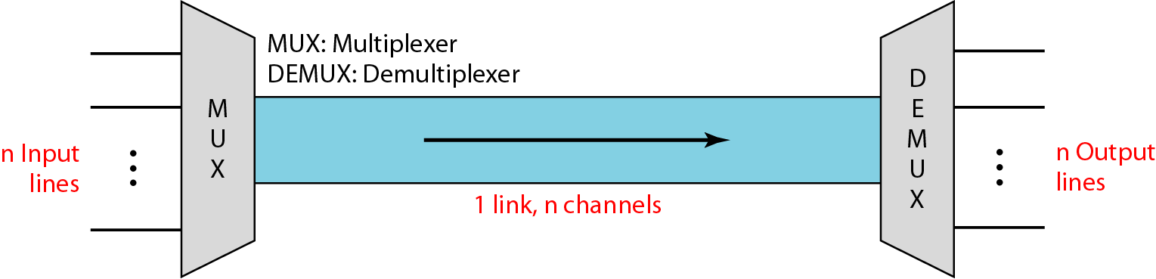
Multiplexing
Objective: Study about basic concept of Multiplexing and its types
Whenever the bandwidth of a medium linking two devices is greater than the bandwidth needs of the devices, the link can be shared. Multiplexing is the set of techniques that allows the simultaneous transmission of multiple signals across a single data link. As data and telecommunications use increases, so does traffic. In real life, we have links with limited bandwidths. Bandwidth utilization is the wise use of available bandwidth to achieve specific goals. Efficiency can be achieved by multiplexing.
8/17/2022
Chitvan Gupta KCS603 CN Unit Number:1

Slide 89
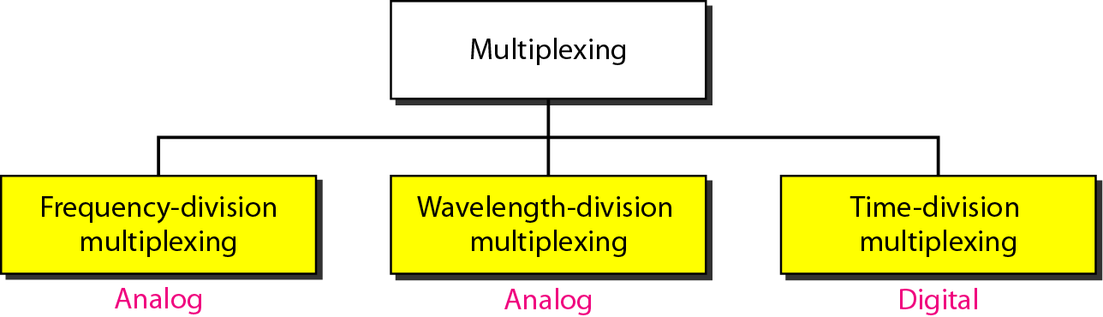
Multiplexing
There are three basic multiplexing techniques: frequency-division multiplexing, wavelength-division multiplexing, and time-division multiplexing. The first two are techniques designed for analog signals, the third, for digital signals.
8/17/2022
Chitvan Gupta KCS603 CN Unit Number:1

Slide 90
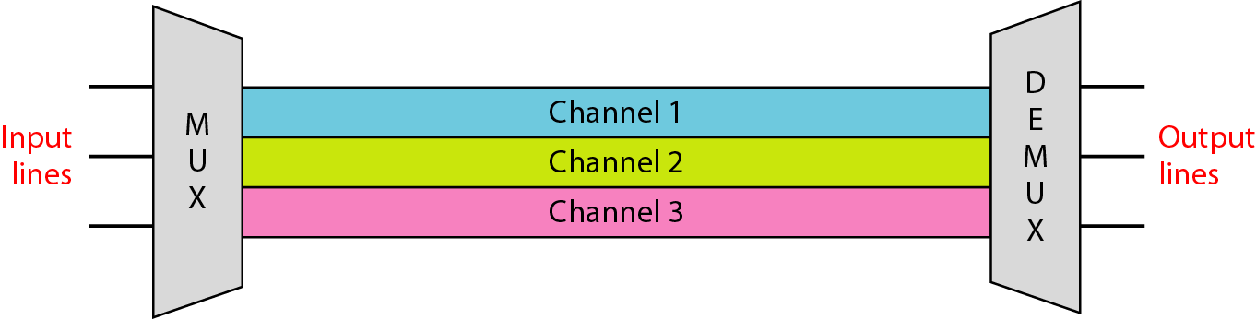
Multiplexing
In a multiplexed system, n lines share the bandwidth of one link. The lines on the left direct their transmission streams to a multiplexer (MUX), which combines them into a single stream (many-to- one).
At the receiving end, that stream is fed into a demultiplexer (DEMUX), which separates the stream back into its component transmissions (one-to-many) and directs them to their corresponding lines.
In the figure, the word link refers to the physical path. The word channel refers to the portion of a link that carries a transmission between a given pair of lines. One link can have many (n) channels.
8/17/2022
Chitvan Gupta KCS603 CN Unit Number:1

Slide 91
Multiplexing
Frequency-division multiplexing (FDM) is an analog technique that can be applied when the bandwidth of a link (in hertz) is greater than the combined bandwidths of the signals to be transmitted.
In FDM, signals generated by each sending device modulate different carder frequencies. These modulated signals are then combined into a single composite signal that can be transported by the link.
Carrier frequencies are separated by sufficient bandwidth to accommodate the modulated signal. These bandwidth ranges are the channels through which the various signals travel.
Channels can be separated by strips of unused bandwidth guard bands to prevent signals from overlapping.
In addition, carrier frequencies must not interfere with the original data frequencies.
8/17/2022
Chitvan Gupta KCS603 CN Unit Number:1

Slide 92
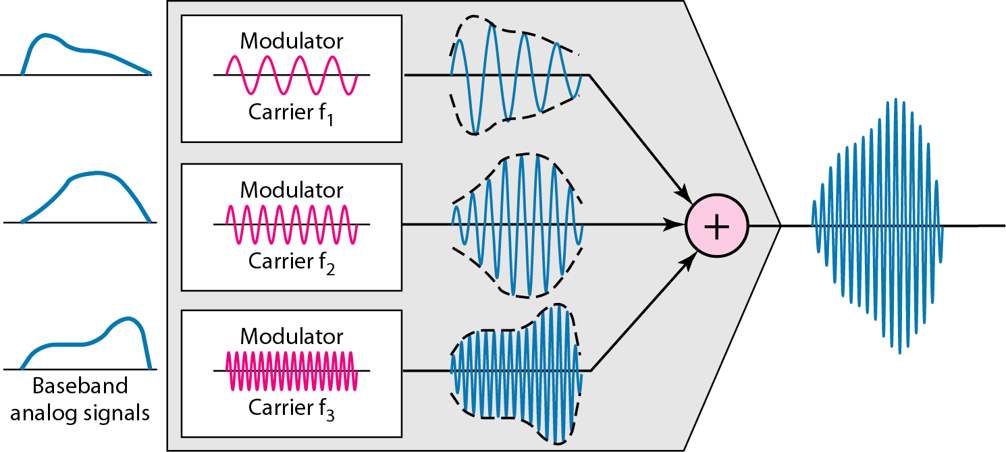
Multiplexing
8/17/2022
Chitvan Gupta KCS603 CN Unit Number:1

Slide 93
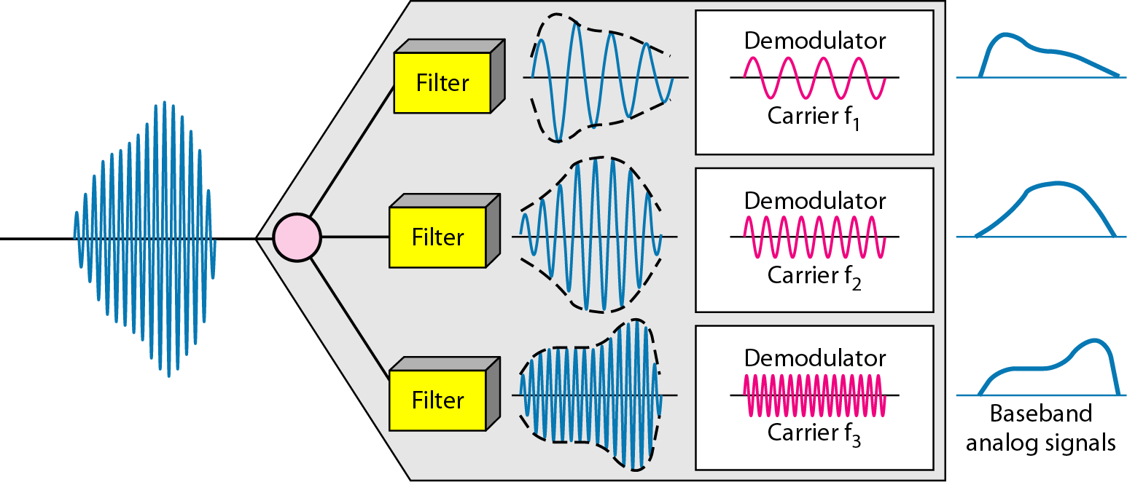
Multiplexing
The de-multiplexer uses a series of filters to decompose the multiplexed signal into its constituent component signals. The individual signals are then passed to a demodulator that separates them from their carriers and passes them to the output lines.
8/17/2022
Chitvan Gupta KCS603 CN Unit Number:1

Slide 94
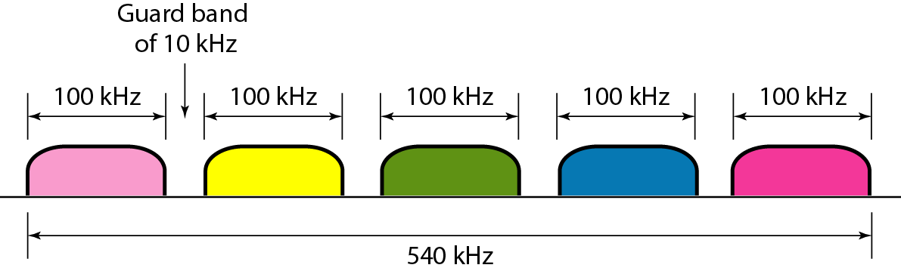
Multiplexing
Five channels, each with a 100-kHz bandwidth, are to be multiplexed together. What is the minimum bandwidth of the link if there is a need for a guard band of 10 kHz between the channels to prevent interference?
Solution
For five channels, we need at least four guard bands. This means that the required bandwidth is at least
5 × 100 + 4 × 10 = 540 kHz
8/17/2022
Chitvan Gupta KCS603 CN Unit Number:1

Slide 95
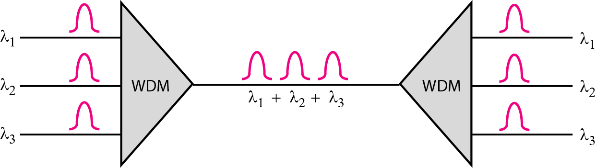
Multiplexing
Wavelength-division multiplexing (WDM) is designed to use the high-data-rate capability of fiber-optic cable. The optical fiber data rate is higher than the data rate of metallic transmission cable. Using a fiber-optic cable for one single line wastes the available bandwidth. Multiplexing allows us to combine several lines into one. WDM is an analog multiplexing technique to combine optical signals. The combining and splitting of light sources are easily handled by a prism. Recall from basic physics that a prism bends a beam of light based on the angle of incidence and the frequency.
8/17/2022
Chitvan Gupta KCS603 CN Unit Number:1

Slide 96
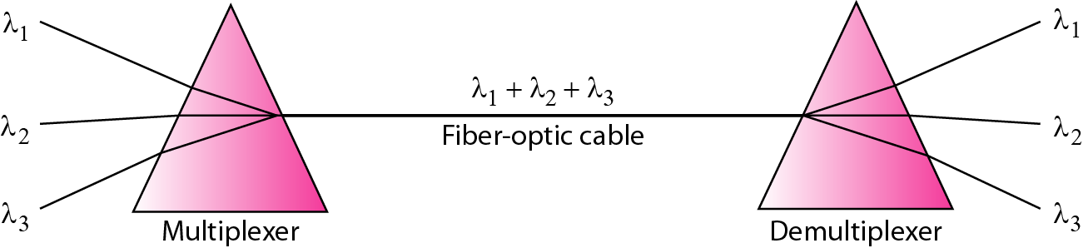
Multiplexing
Using this technique, a multiplexer can be made to combine several input beams of light, each containing a narrow band of frequencies, into one output beam of a wider band of frequencies. A de-multiplexer can also be made to reverse the process.
One application of WDM is the SONET network in which multiple optical
fiber lines are multiplexed and de-multiplexed. A new method, called dense WDM (DWDM), can multiplex a very large number of channels by spacing channels very close to one another. It achieves even greater efficiency.
8/17/2022
Chitvan Gupta KCS603 CN Unit Number:1

Slide 97
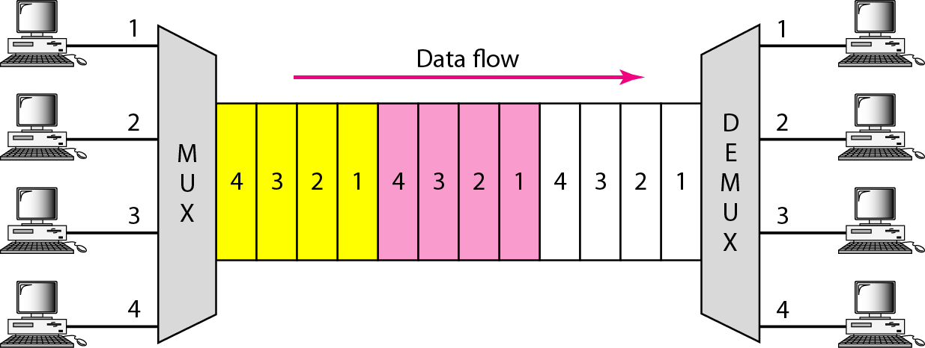
Multiplexing
Time-Division Multiplexing : Time-division multiplexing (TDM) is a digital process that allows several connections to share the high bandwidth of a link. Instead of sharing a portion of the bandwidth as in FDM, time is shared. Each connection occupies a portion of time in the link. Note that the same link is used as in FDM; here, however, the link is shown sectioned by time rather than by frequency. In the figure, portions of signals 1, 2, 3, and 4 occupy the link sequentially. TDM is a digital multiplexing technique for combining several low-rate channels into one high-rate one.
8/17/2022
Chitvan Gupta KCS603 CN Unit Number:1

Slide 98
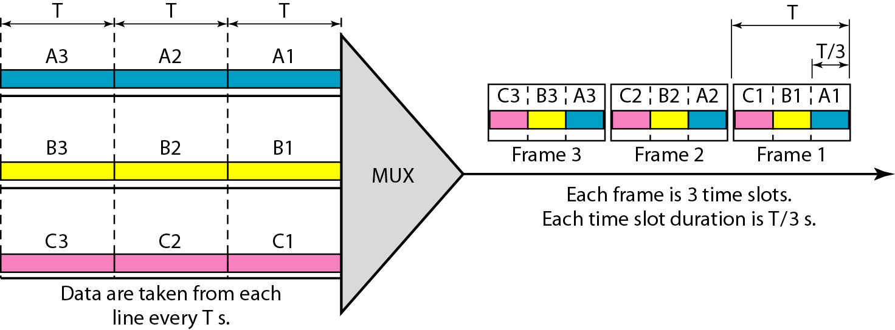
Multiplexing
We can divide TDM into two different schemes: synchronous and statistical.
In synchronous TDM, each input connection has an allotment in the output even if it is not sending data.
Time Slots and Frames: In synchronous TDM, the data flow of each input connection is divided into units, where each input occupies one input time slot. A unit can be 1 bit, one character, or one block of data. Each input unit becomes one output unit and occupies one output time slot. However, the duration of an output time slot is n times shorter than the duration of an input time slot. If an input time slot is T s, the output time slot is T/n s, where n is the number of connections. In other words, a unit in the output connection has a shorter duration; it travels faster. In synchronous TDM, the data rate of the link is n times faster, and the unit duration is n times shorter.
8/17/2022
Chitvan Gupta KCS603 CN Unit Number:1

Slide 99
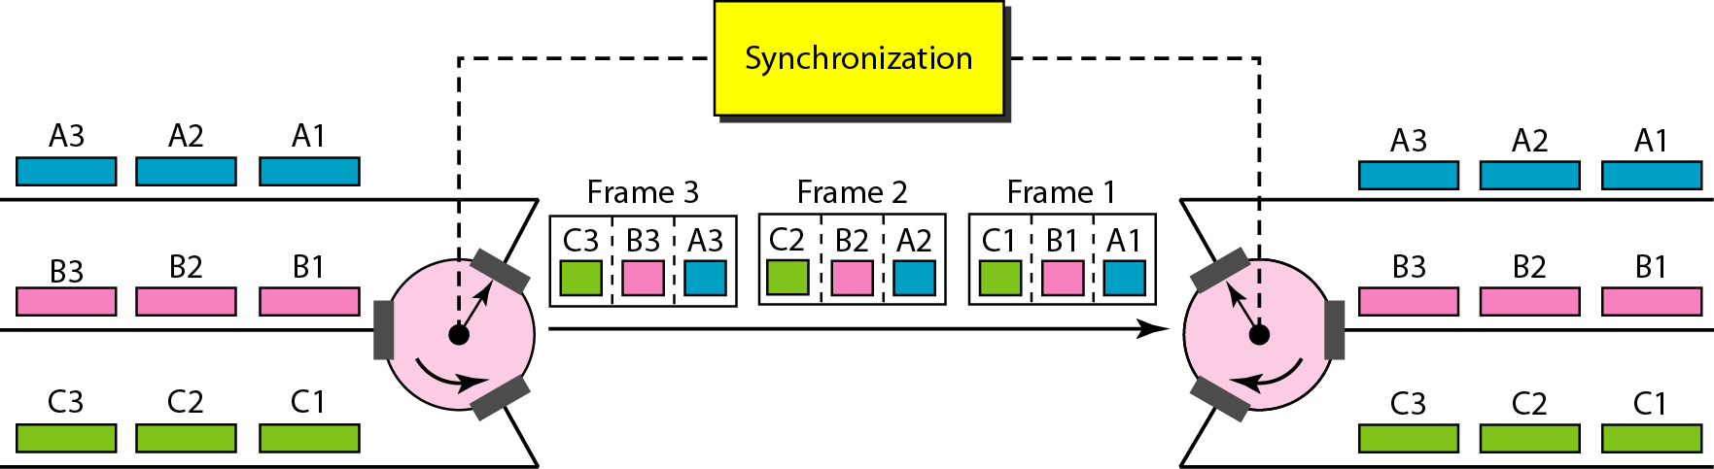
Multiplexing
Interleaving
TDM can be visualized as two fast-rotating switches, one on the multiplexing side and the other on the demultiplexing side. The switches are synchronized and rotate at the same speed, but in opposite directions. On the multiplexing side, as the switch opens in front of a connection, that connection has the opportunity to send a unit onto the path. This process is called interleaving.
8/17/2022
Chitvan Gupta KCS603 CN Unit Number:1

Slide 100
Faculty Video Links, Youtube & NPTEL Video Links and Online Courses Details
Youtube/other Video Links
https://www.youtube.com/watch?v=JvXro0dzJY8
https://www.youtube.com/watch?v=JvXro0dzJY8
https://www.youtube.com/watch?v=jOIB
https://www.youtube.com/watch?v=xHyJNkiGRd8

Slide 101
Daily Quiz
Which of the following network device has the slowest type of connection?
A: DSL B: Router C: Bridges D: Dial-up modems
2. Which networking device connects one LAN to other LAN using same
protocol?
A: Router B: Switch C: Bridge D: Modem
3. Straight through cable is used for connecting
a. Switch to switch b. Hub to switch c. System to system d. System to switch
4. OSI model is-
a. 7 layers b. 6 layer c. 5 layer d. 4 layer
6. TCP/IP model contain –
a. 5 b. 7 c. 3 d. none of the above
7. ISDN stand for –
8. IEEE stand for –
9. Which topology is a example of multipoint connection-
a. BUS b. STAR c. RING d. MESH
10. Step Index & Graded Index is example of which type of cable-
a. Twistted pair b. Coaxial c. Fiber Optics d. None of the above

Slide 102
Weekly Assignment
Name the functions of physical layer (CO1)
List the layers of OSI model in bottom up order (CO1)
Compare OSI and TCP/IP model (CO1)
Compare LAN , MAN, WAN (CO1)

Slide 103
Weekly Assignment
Name the drawbacks of unipolar encoding (CO1)
Name the drawbacks of bipolar encoding (CO1)
Name the advantages of manchester encoding (CO1)
Draw encoded signal for 1000110 using NRZ-I (CO1)

Slide 104
MCQ s
1. In.................... each packet of a message need not follow the same path From sender to receiver. (CO1)
(A) Circuit switching
(B) message switching
(C) a virtual approach to packet switching
(D) The datagram approach to packet switching
2. A set of rules that governs data communication: (CO1)
A. Protocols
B. Standards
C. RFCs
D. None of the mentioned

Slide 105
MCQ s
3. Communication channel is shared by all the machines on the network in:
A. broadcast network (CO1)
B. unicast network
C. multicast network
D. none of the mentioned
4. Which one of the following computer network is built on the top of another network? (CO1)
A. prior network
B. chief network
C. prime network
D. overlay network

Slide 106
MCQ s
5. Draw digital encoded signal for 101001001
NRZ
RZ
NRZ-I
Manchester
Differential manchester

Slide 107
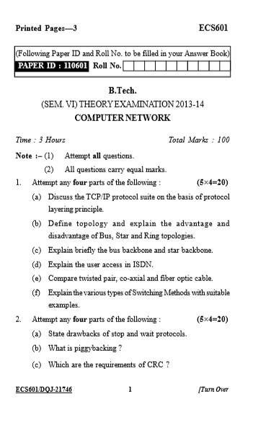
Old Question Papers

Slide 108
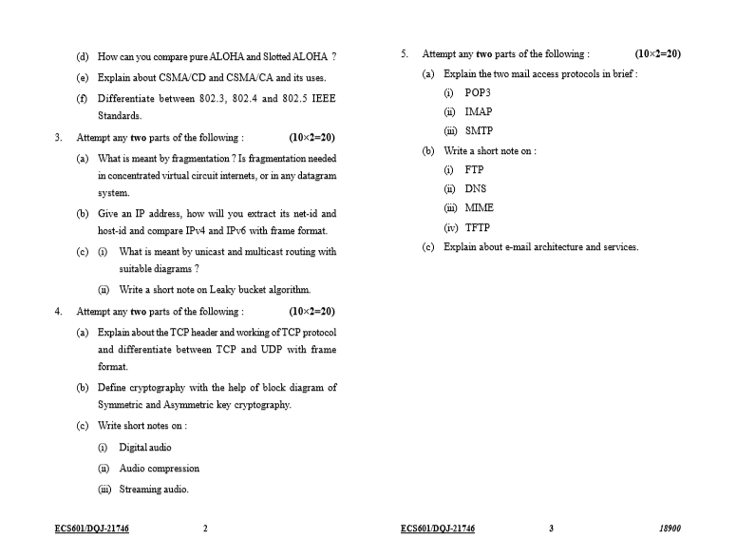
Old Question Papers

Slide 109
Expected Questions for University Exam
Q1. Compare OSI model and TCP/IP model (CO1)
Q2. Explain the transmission in fiber optical cable. (CO1)
Q3. Compare all topology methods , list the advantages and drawback of different topologies (CO1)
Q4. List the functions of each layer in OSI model (CO1)
Q5. List the parameters for a efficient network (CO1)
Q6. Name the functions of physical layer (CO1)

Slide 110
Expected Questions for University Exam
Q7. List the layers of OSI model in bottom up order. (CO1)
Q8. How TCP/IP model introduced? (CO1)
Q9. Name the topologies which provide point to point communication. (CO1)
Q10. Name the bipolar encoding methods. (CO1)
Q11. What is the maximum length allowed for a UTP cable? (CO1)
Q12. How does a network topology affect your decision in setting up a network? (CO1)
Q13. List the type of cables used in computer network. (CO1)
Q14. Name the multiplexing methods. (CO1)

Slide 111
Summary
Unit 1 topics have been discussed in above slides, introduction to computer network is covered and type of networks has been introduced. Different transmission media has been explained and encoding methods are represented.(CO1)

Slide 112
References
Thank You
Books:
Forouzen, "Data Communication and Networking",TMH
A.S. Tanenbaum, Computer Networks, Pearson Education
W. Stallings, Data and Computer Communication, MacmillanPress

